Slide 1
Java Remote Method Invocation (RMI)
Overview of RMI
Java RMI allowed programmer to execute remote function class using the same semantics as local functions calls.
Local Machine (Client)
SampleServer remoteObject;
int s;
…
s = remoteObject.sum(1,2);
System.out.println(s);
Remote Machine (Server)
public int sum(int a,int b) {
return a + b;
}
1,2
3

Slide 2
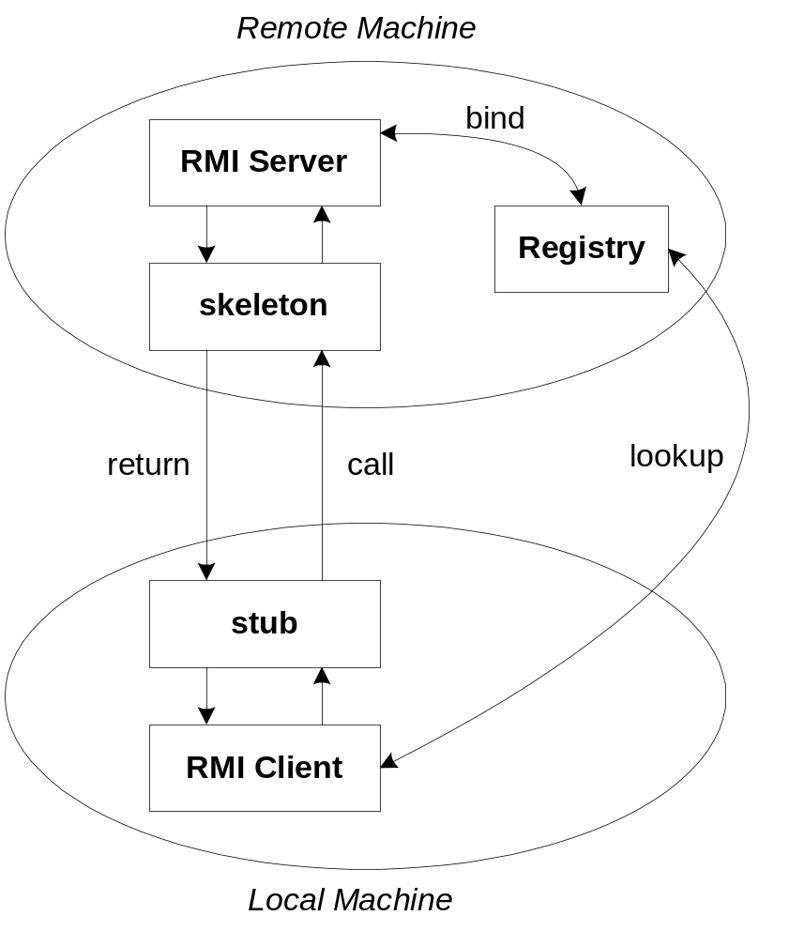
The General RMI Architecture
The server must first bind its name to the registry
The client lookup the server name in the registry to establish remote references.
The Stub serializing the parameters to skeleton, the skeleton invoking the remote method and serializing the result back to the stub.

Slide 3
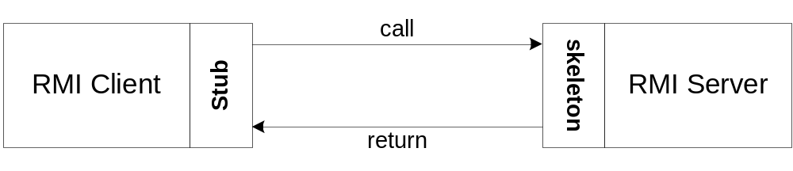
The Stub and Skeleton
A client invokes a remote method, the call is first forwarded to stub.
The stub is responsible for sending the remote call over to the server-side skeleton
The stub opening a socket to the remote server, marshaling the object parameters and forwarding the data stream to the skeleton.
A skeleton contains a method that receives the remote calls, unmarshals the parameters, and invokes the actual remote object implementation.

Slide 4
Steps for Developing an RMI System
1. Define the remote interface
2. Develop the remote object by implementing the remote interface.
3. Develop the client program.
4. Compile the Java source files.
5. Generate the client stubs and server skeletons.
6. Start the RMI registry.
7. Start the remote server objects.
8. Run the client

Slide 5
Step 1: Defining the Remote Interface
To create an RMI application, the first step is the defining of a remote interface between the client and server objects.
/* Fibonacci.java */
import java.rmi.*;
import java.math.BigInteger;
public interface Fibonacci extends Remote {
public BigInteger getFibonacci(int n) throws RemoteException;
public BigInteger getFibonacci(BigInteger n) throws RemoteException;
}

Slide 6
Step 2: Develop the remote object and its interface
The server is a simple unicast remote server.
Create server by extending java.rmi.server.UnicastRemoteObject.
The server uses the RMISecurityManager to protect its resources while engaging in remote communication.
/* FibonacciImpl.java */
import java.rmi.*;
import java.rmi.server.UnicastRemoteObject;
import java.math.BigInteger;
public class FibonacciImpl extends UnicastRemoteObject implements Fibonacci {
public FibonacciImpl() throws RemoteException {
super();
}

Slide 7
Step 2: Develop the remote object and its interface
Implement the remote methods
public BigInteger getFibonacci(int n) throws RemoteException {
return this.getFibonacci(new BigInteger(Long.toString(n)));
}

Slide 8
public BigInteger getFibonacci(BigInteger n) throws RemoteException {
System.out.println("Calculating the " + n + "th Fibonacci number");
BigInteger zero = new BigInteger("0");
BigInteger one = new BigInteger("1");
if (n.equals(zero)) return one;
if (n.equals(one)) return one;
BigInteger i = one;
BigInteger low = one;
BigInteger high = one;
while (i.compareTo(n) == -1) {
BigInteger temp = high;
high = high.add(low);
low = temp;
i = i.add(one);
}
return high;
}
}

Slide 9
The server must bind its name to the registry, the client will look up the server name.
Use java.rmi.Naming class to bind the server name to registry.
In the main method of your server object, the RMI security manager is created and installed.

Slide 10
Step 2: Develop the remote object and its interface
/*FibonacciServer.java*/
import java.net.*;
import java.rmi.*;
public class FibonacciServer {
public static void main(String[] args) {
try {
FibonacciImpl f = new FibonacciImpl();
Naming.rebind("fibonacci", f);
System.out.println("Fibonacci Server ready.");
}
catch (RemoteException rex) {
System.out.println("Exception in FibonacciImpl.main: " + rex);
}
catch (MalformedURLException ex) {
System.out.println("MalformedURLException " + ex);
}
}
}

Slide 11
Step 3: Develop the client program
In order for the client object to invoke methods on the server, it must first look up the name of server in the registry. You use the java.rmi.Naming class to lookup the server name.
The server name is specified as URL in the from ( rmi://host:port/name )
Default RMI port is 1099.
The name specified in the URL must exactly match the name that the server has bound to the registry.
The remote method invocation is programmed using the remote interface name as prefix and the remote method name as suffix.

Slide 12
Step 3: Develop the client program
import java.rmi.*;
import java.net.*;
import java.math.BigInteger;
public class FibonacciClient {
public static void main(String args[]) {
if (args.length == 0 || !args[0].startsWith("rmi:")) {
System.err.println(
"Usage: java FibonacciClient rmi://host.domain:port/fibonacci number");
return;
}
try { Object o = Naming.lookup(args[0]);
Fibonacci calculator = (Fibonacci) o;
for (int i = 1; i < args.length; i++) {
try { BigInteger index = new BigInteger(args[i]);
BigInteger f = calculator.getFibonacci(index);
System.out.println("The " + args[i] + "th Fibonacci number is “ + f);
}
catch (NumberFormatException e) {
System.err.println(args[i] + "is not an integer.");
} } }
catch (MalformedURLException ex) { System.err.println(args[0] + " is not a valid RMI URL"); }
catch (RemoteException ex) { System.err.println("Remote object threw exception " + ex); }
catch (NotBoundException ex) { System.err.println(
"Could not find the requested remote object on the server");
} } }

Slide 13
Step 4 & 5: Compile the Java source files & Generate the client stubs and server skeletons
Once the interface is completed, you need to generate stubs and skeleton code. The RMI system provides an RMI compiler (rmic) that takes your generated interface class and procedures stub code on its self.
    > javac FibonacciServer.java
    > javac FibonacciImpl.java
    > rmic FibonacciImpl
    > javac FibonacciClient.java

Slide 14
Step 6: Start the RMI registry
The RMI applications need install to Registry. And the Registry must start manual by call rmiregisty.
The rmiregistry us uses port 1099 by default. You can also bind rmiregistry to a different port by indicating the new port number as : rmiregistry <new port>
> start rmiregistry

Slide 15
Steps 7 & 8: Start the remote server objects & Run the client
Once the Registry is started, the server can be started and will be able to store itself in the Registry.
>java FibonacciServer
Fibonacci Server ready.
>java FibonacciClient rmi://localhost/fibonacci 0 1 2 3 4 5 55 155

Slide 16
Write a remote interface to add two integers and Implement the remote server also. Write a client program to pass those two values and get back the result.

Slide 17
The java.rmi Package
The java.rmi package contains the classes that are seen by clients (objects that invoke remote methods). Both clients and servers should import java.rmi. This package contains one interface, three classes, and a handful of exceptions.
The Remote Interface - tags objects as remote objects. It doesn't declare any methods. The methods that are declared in the interface are the methods that can be invoked remotely.

Slide 18
The Naming Class
The java.rmi.Naming class talks to a registry running on the server in order to map URLs like rmi://login.ibiblio.org/myRemoteObject to particular remote objects on particular hosts. Each entry in the registry has a name and an object reference. Clients give the name (via a URL) and get back a reference to the remote object.
The Naming class has five public methods:
  list( ), to list all the names bound in the registry;
  lookup( ), to find a specific remote object given its URL;
  bind( ), to bind a name to a specific remote object;
  rebind( ), to bind a name to a different remote object;
  unbind( ), to remove a name from the registry.

Slide 19
public static String[] list(String url) throws RemoteException, MalformedURLException
  The list( ) method returns an array of strings, one for each URL that is currently bound. The url argument is the URL of the Naming registry to query. Only the protocol, host, and port are used. The path part of the URL is ignored. list( ) throws a MalformedURLException if url is not a valid rmi URL. A RemoteException is thrown if anything else goes wrong, such as the registry's not being reachable or refusing to supply the requested information.

Slide 20
program that lists all the names currently bound in a particular registry
import java.rmi.*;
public class RegistryLister {
public static void main(String[] args) {
int port = 1099;
if (args.length == 0) { System.err.println("Usage: java RegistryLister host port"); return; }
String host = args[0];
if (args.length > 1) { try { port = Integer.parseInt(args[1]);
if (port <1 || port > 65535) port = 1099; }
catch (NumberFormatException ex) {} }
String url = "rmi://" + host + ":" + port + "/";
try { String[] remoteObjects = Naming.list(url);
for (int i = 0; i < remoteObjects.length; i++) { System.out.println(remoteObjects[i]); } }
catch (RemoteException ex) { System.err.println(ex); }
catch (java.net.MalformedURLException ex) { System.err.println(ex); }
}
}

Slide 21
public static Remote lookup(String url) throws RemoteException, NotBoundException, AccessException, MalformedURLException
  A client uses the lookup() method to retrieve the remote object associated with the file portion of the name; so, given the URL rmi://login.ibiblio.org:2001/myRemoteObject, it would return the object bound to myRemoteObject from login.ibiblio.org on port 2,001.
  This method throws a NotBoundException if the remote server does not recognize the name. It throws a RemoteException if the remote registry can't be reached; for instance, because the network is down or because no registry service is running on the specified port. An AccessException is thrown if the server refuses to look up the name for the particular host. Finally, if the URL is not a proper rmi URL, it throws a MalformedURLException.

Slide 22
public static void bind(String url, Remote object) throws RemoteException, AlreadyBoundException, MalformedURLException, AccessException
  A server uses the bind( ) method to link a name like myRemoteObject to a remote object. If the binding is successful, clients will be able to retrieve the remote object stub from the registry using a URL like rmi://login.ibiblio.org:2001/myRemoteObject.
  Many things can go wrong with the binding process. bind() throws a MalformedURLException if url is not a valid rmi URL. It throws a RemoteException if the registry cannot be reached. It throws an AccessException, a subclass of RemoteException, if the client is not allowed to bind objects in this registry. If the URL is already bound to a local object, it throws an AlreadyBoundException.

Slide 23
public static void unbind(String url) throws RemoteException, NotBoundException, AlreadyBoundException, MalformedURLException, AccessException
  The unbind( ) method removes the object with the given URL from the registry. It's the opposite of the bind( ) method. What bind( ) has bound, unbind( ) releases. unbind( ) throws a NotBoundException if url was not bound to an object in the first place. Otherwise, this method can throw the same exceptions for the same reasons as bind().

Slide 24
public static void rebind(String url, Remote object) throws RemoteException, AccessException, MalformedURLException
  The rebind( ) method is just like the bind( ) method, except that it binds the URL to the object, even if the URL is already bound. If the URL is already bound to an object, the old binding is lost. Thus, this method does not throw an AlreadyBoundException. It can still throw RemoteException, AccessException, or MalformedURLException, which have the same meanings as they do when thrown by bind().

Slide 25
Remote Exceptions
AccessException - A client tried to do something that only local objects are allowed to do.
AlreadyBoundException -The URL is already bound to another object.
ConnectException -The server refused the connection.
ConnectIOException -An I/O error occurred while trying to make the connection between the local and the remote host.
MarshalException -An I/O error occurred while attempting to marshal (serialize) arguments to a remote method. A corrupted I/O stream could cause this exception; making the remote method call again might be successful.
UnmarshalException - An I/O error occurred while attempting to unmarshal (deserialize) the value returned by a remote method. A corrupted I/O stream could cause this exception; making the remote method call again might be successful.
NoSuchObjectException - The object reference is invalid or obsolete. This might occur if the remote host becomes unreachable while the program is running, perhaps because of network congestion, system crash, or other malfunction.

Slide 26
NotBoundException - The URL is not bound to an object. This might be thrown when you try to reference an object whose URL was rebound out from under it.
RemoteException - The generic superclass for all exceptions having to do with remote methods.
ServerError - Despite the name, this is indeed an exception, not an error. It indicates that the server threw an error while executing the remote method.
ServerException - A RemoteException was thrown while the remote method was executing.
StubNotFoundException - The stub for a class could not be found. The stub file may be in the wrong directory on the server, there could be a namespace collision between the class that the stub substitutes for and some other class, or the client could have requested the wrong URL.
UnexpectedException - Something unforeseen happened. This is a catchall that occurs only in bizarre situations.
UnknownHostException- The host cannot be found. This is very similar to java.net.UnknownHostException.

Slide 27
The java.rmi.registry Package
A registry advertises the availability of the server's remote objects. Clients query the registry to find out what remote objects are available and to get remote references to those objects. You've already seen one: the java.rmi.Naming class for interfacing with registries.
The Registry interface and the LocateRegistry class allow clients to retrieve remote objects on a server by name. A RegistryImpl is a subclass of RemoteObject, which links names to particular RemoteObject objects. Clients use the methods of the LocateRegistry class to retrieve the RegistryImpl for a specific host and port.

Slide 28
The Registry Interface
java.rmi.Naming class implements this interface.
The java.rmi.registry.Registry interface has five public methods:
  bind( ), to bind a name to a specific remote object;
  list( ), to list all the names bound in the registry;
  lookup( ), to find a specific remote object given its URL;
  rebind( ), to bind a name to a different remote object;
  unbind( ), to remove a name from the registry.

Slide 29
The LocateRegistry Class
  lets the client find the registry in the first place. This is achieved with five overloaded versions of the static LocateRegistry.getRegistry() method:
    public static Registry getRegistry( ) throws RemoteException
    public static Registry getRegistry(int port) throws RemoteException
    public static Registry getRegistry(String host) throws RemoteException
    public static Registry getRegistry(String host, int port) throws RemoteException
    public static Registry getRegistry(String host, int port, RMIClientSocketFactory factory) throws RemoteException

Slide 30
The java.rmi.server Package
The RemoteObject Class
  public abstract class RemoteObject extends Object implements Remote, Serializable
The RemoteServer Class
  The RemoteServer class extends RemoteObject; it is an abstract superclass for server implementations such as UnicastRemoteObject. It provides a few simple utility methods needed by most server objects:
RemoteServer has two constructors:
  protected RemoteServer( )
  protected RemoteServer(RemoteRef r)

Slide 31
Getting information about the client
  public static String getClientHost( ) throws ServerNotActiveException
  RemoteServer.getClientHost() returns a String that contains the hostname of the client that invoked the currently running method. This method throws a ServerNotActiveException if the current thread is not running a remote method.

Slide 32
The UnicastRemoteObject Class - is a concrete subclass of RemoteServer. To create a remote object, you can extend UnicastRemoteObject.
A UnicastRemoteObject runs on a single host, uses TCP sockets to communicate, and has remote references that do not remain valid across server restarts.
  protected UnicastRemoteObject( ) throws RemoteException
  protected UnicastRemoteObject(int port) throws RemoteException
  protected UnicastRemoteObject(int port, RMIClientSocketFactory csf, RMIServerSocketFactory ssf) throws RemoteException

Slide 33
java.rmi.server exceptions
ExportException - You're trying to export a remote object on a port that's already in use.
ServerNotActiveException - An attempt was made to invoke a method in a remote object that wasn't running.
ServerCloneException - An attempt to clone a remote object on the server failed.
SocketSecurityException - This subclass of ExportException is thrown when the SecurityManager prevents a remote object from being exported on the requested port.

Slide 34
Java Mail API
The JavaMail API is a standard extension to Java that provides a class library for email clients.
The JavaMail API provides a common framework for managing electronic mail, by defining a set of abstract classes that represent the components of a mail system.
Programs use the JavaMail API to communicate with SMTP, POP, and IMAP servers to send and receive email.

Slide 35
What Is the JavaMail API?
The JavaMail API is a fairly high-level representation of the basic components of any email system.
The components are represented by abstract classes in the javax.mail package.
javax.mail.Message represents an email message-It declares abstract methods to get and set various kinds of envelope information for the message, such as the sender and addressee, the date sent, and the subject of the message.

Slide 36
javax.mail.Folder represents a message container- It declares abstract methods to get messages from a folder, move messages between folders, and delete messages from a folder.
If you want to work with standard internet email, use javax.mail.MimeMessage instead of javax.mail.Message, javax.mail.InternetAddress instead of javax.mail.Address, and com.sun.mail.imap.IMAPStore instead of javax.mail.Store.

Slide 37
Service providers implement particular protocols.
A service provider is a group of concrete subclasses of the abstract JavaMail API classes that specialize the general API to a particular protocol and mail format.
These subclasses are probably (though not necessarily) organized into one package.
Some of these (IMAP, SMTP) are provided by Sun with its reference implementation in the undocumented com.sun.mail package.
And some (POP) are available from both Sun and third parties.
It's freely available from http://java.sun.com/products/javamail.

Slide 38
Sending Email
8 Steps to send an email:
  Set the mail.host property to point to the local mail server.
  Start a mail session with the Session.getInstance() method.
  Create a new Message object, probably by instantiating one of its concrete subclasses.
  Set the message's From: address.
  Set the message's To: address.
  Set the message's Subject:.
  Set the content of the message.
  Send the message with the Transport.send( ) method.

Slide 39
Example:
  Properties props = new Properties( );
  props.put("mail.host", "mail.cloud9.net");
  Session mailConnection = Session.getInstance(props, null);
  Message msg = new MimeMessage(mailConnection);
  Address bill = new InternetAddress("god@microsoft.com", "Bill Gates");
  Address elliotte = new InternetAddress("elharo@metalab.unc.edu");
  msg.setFrom(bill);
  msg.setRecipient(Message.RecipientType.TO, elliotte);
  msg.setSubject("You must comply.");
  msg.setContent("Resistance is futile. You will be assimilated!", "text/plain");
  Transport.send(msg);

Slide 40
Receiving Mail
more complex than sending it.
retrieving email generally requires providing both a username and a password.
SMTP uses only 14 different commands, and a simple email client can be implemented with just five of them.
POP3 has 12 commands, almost all of which a client must be able to handle;
IMAP4 has 24 different commands.

Slide 41
12 steps to reading a remote mailbox
  Set up the properties for the connection.
  Construct the Authenticator for the connection.
  Get a Session object with Session.getDefaultInstance( ).
  Use the session's getStore( ) method to return a Store.
  Connect to the store.
  Get the INBOX folder from the store with the getFolder() method.
  Open the INBOX folder.
  Open the folder you want inside the INBOX folder.
  Get the messages from the folder as an array of Message objects.
  Iterate through the array of messages, processing each one in turn using the methods of the Message class.
  Close the folder.
  Close the store.

Slide 42
Example:
  Properties props = new Properties( );
  Authenticator a = null;
  Session session = Session.getDefaultInstance(props, a);
  Store store = session.getStore("POP3");
  store.connect("mail.cloud9.net", "elharo", "my_password");
  Folder inbox = store.getFolder("INBOX");
  inbox.open(Folder.READ_ONLY);
  Message[] messages = inbox.getMessages( );
  for (int i = 0; i < messages.length; i++) {
    System.out.println(“--------- Message " + (i+1) + " ------------");
    messages[i].writeTo(System.out); }
  inbox.close(false);
  store.close( );

Slide 43

Write a java program to send and receive emails

Slide 44
Addresses
The javax.mail.Address class
public abstract class Address extends Object
There are two of these subclasses in the standard JavaMail API: InternetAddress for SMTP email and NewsAddress for Usenet newsgroups:
  public class InternetAddress extends Address
  public class NewsAddress extends Address

Slide 45
The Address Class
It has only three methods, all abstract
  public abstract String getType( )
  public abstract String toString( )
  public abstract boolean equals(Object o)
getType( ) method returns a string such as "rfc822" or "news" that indicates the kind of Address object.

Slide 46
The InternetAddress Class
An InternetAddress object represents an RFC 822-style email address. This is the standard Internet-style email address that is rapidly supplanting all other proprietary formats. It looks like elharo@metalab.unc.edu or ask_tim@oreilly.com
The state of an InternetAddress object is maintained by three protected fields:
  protected String address - actual email address
  protected String personal - name
  protected String encodedPersonal

Slide 47
There are four overloaded constructors for InternetAddress objects:
  public InternetAddress( )
  public InternetAddress(String address) throws AddressException
  public InternetAddress(String address, String personal) throws UnsupportedEncodingException
  public InternetAddress(String address, String personal, String charset) throws UnsupportedEncodingException

Slide 48
9 instance methods in this class
  public void setAddress(String address)
  public void setPersonal(String name, String charset) throws UnsupportedEncodingException
  public void setPersonal(String name) throws UnsupportedEncodingException
  public String getAddress( )
  public String getPersonal( )
  public String getType( )
  public String toString( )
  public boolean equals(Object o)
  public int hashCode( )

Slide 49
The NewsAddress Class
JavaMail API can also access Usenet news.
  public class NewsAddress extends Address
A NewsAddress object represents a Usenet newsgroup name, such as comp.lang.java.machine. It may include the hostname for the news server as well. The state of a NewsAddress object is maintained by
  protected String newsgroup - name of the newsgroup
  protected String host - either null or contains the hostname of the news server

Slide 50
public NewsAddress( )
public NewsAddress(String newsgroup)
public NewsAddress(String newsgroup, String host)
Example:
  Address netscape_java = new NewsAddress("netscape.devs-java.", "secnews.netscape.com");

Slide 51
eight instance methods in this class
  public String getType( )
  public String getHost( )
  public String getNewsgroup( )
  public void setNewsgroup(String newsgroup)
  public void setHost(String host)
  public String toString( )
  public boolean equals(Object o)
  public int hashCode( )

Slide 52
There are also two static utility methods for converting addresses to and from strings:
  public static String toString(Address[] addresses) throws ClassCastException
  public static NewsAddress[] parse(String newsgroups) throws AddressException
A ClassCastException is thrown if any of the Address objects in the array are not more specifically NewsAddress objects.
The parse( ) method reverses this operation, converting a comma-separated String of newsgroup names, such as "comp.lang.java.programmer,comp.lang.java.gui,comp.lang.java.help", into an array of NewsAddress objects.
It throws an AddressException if the newsgroups argument is not a comma-separated list of newsgroup names.

Slide 53
The URLName Class
javax.mail.URLName represents the name of a URL
URL names are mainly used as convenient ways to identify folders and stores with nonstandard URLs that don't have a matching protocol handler
  public class URLName Object

Slide 54
The Constructors
three overloaded URLName constructors
  public URLName(String protocol, String host, int port, String file, String userName, String password)
  public URLName(URL url)
  public URLName(String url)

Slide 55
Parsing Methods
public int getPort( )
public String getProtocol( )
public String getFile( )
public String getRef( )
public String getHost( )
public String getUsername( )
public String getPassword( )
public URL getURL( ) throws MalformedURLException

Slide 56
The Message Class
The javax.mail.Message class is the abstract superclass for all individual emails, news postings, and similar messages
public abstract class Message extends Object implements Part

Slide 57
Creating Messages
Message class has three constructors:
protected Message( )
protected Message(Folder folder, int messageNumber)
protected Message(Session session)

Slide 58
Replying to messages
public abstract Message reply(boolean replyToAll) throws MessagingException
This method creates a new Message object with the same subject prefixed with "Re:", and addressed to the sender of the original message.
If replyToAll is true, the message is addressed to all known recipients of the original message.

Slide 59
Getting messages from folders
public abstract Message getMessage(int messageNumber) throws MessagingException
public Message[] getMessages(int start, int end) throws MessagingException
public Message[] getMessages(int[] messageNumbers) throws MessagingException
public Message[] getMessages( ) throws MessagingException

Slide 60
Basic Header Info
From levi@blazing.sunspot.noao.edu Fri Aug 5 10:57:08 1994
Date: Fri, 27 Aug 2004 10:57:04 +0700
From: levi@blazing.sunspot.noao.edu (Denise Levi)
To: volleyball@sunspot.noao.edu
Subject: Apologies
Content-Length: 517
Status: RO
X-Lines: 13

Slide 61
Flags
A flag is an instance of the javax.mail.Flags class:
public class Flags extends Object implements Cloneable
Seven flags are predefined as instances of the public static inner class Flags.Flag.
  Flags.Flag.ANSWERED
  Flags.Flag.DELETED
  Flags.Flag.DRAFT
  Flags.Flag.FLAGGED
  Flags.Flag.RECENT
  Flags.Flag.SEEN
  Flags.Flag.USER

Slide 62
public abstract Flags getFlags( ) throws MessagingException
public boolean isSet(Flags.Flag flag) throws MessagingException
public abstract void setFlags(Flags flag, boolean set) throws MessagingException, IllegalWriteException, IllegalStateException
public void setFlag(Flags.Flag flag, boolean set) throws MessagingException, IllegalWriteException, IllegalStateException

Slide 63
Folders
public Folder getFolder( ) - It returns null if the message isn't contained in a folder.
public int getMessageNumber( )
protected void setMessageNumber(int number)
It may be important to check whether a message has been expunged before working with it.
  public boolean isExpunged( )
protected void setExpunged(boolean expunged)

Slide 64
Searching
The match( ) method determines whether a Message satisfies particular search criteria.
public boolean match(SearchTerm term) throws MessagingException

Slide 65
The Part Interface
Both Message and BodyPart implement the Part interface. Every Message is a Part.
The Part interface declares three kinds of methods:
  Methods for getting and setting the attributes of the part
  Methods for getting and setting the headers of the part
  Methods for getting and setting the contents of the part

Slide 66
Attributes
Size - The approximate number of bytes in the part
Line count - The number of lines in the part
Disposition - Whether the part is an attachment or should be displayed inline
Description - A brief text summary of the part
Filename - The name of the file that the attachment came from

Slide 67
public int getSize( ) throws MessagingException
public int getLineCount( ) throws MessagingException
public String getDisposition( ) throws MessagingException
public String getDescription( ) throws MessagingException
public String getFileName( ) throws MessagingException, ParseException

Slide 68
Write a program to read mail attributes

Slide 69
Headers
The getHeader( ) method gets the values of all the headers with a name that matches the name argument.
  public String[] getHeader(String name) throws MessagingException
The setHeader( ) method adds a new header to an outgoing message:
  public void setHeader(String name, String value) throws MessagingException, IllegalWriteException, IllegalStateException
  .

Slide 70
public void addHeader(String name, String value) throws MessagingException, IllegalWriteException, IllegalStateException
public void removeHeader(String name) throws MessagingException, IllegalWriteException, IllegalStateException
public Enumeration getAllHeaders( ) throws MessagingException
public class Header extends Object
  public Header(String name, String value)
  public String getName( )
  public String getValue( )
public Enumeration getMatchingHeaders(String[] names) throws MessagingException
public Enumeration getNonMatchingHeaders(String[] names) throws MessagingException

Slide 71
Multipart Messages and File Attachments
To send a multipart message using the JavaMail API, all you have to do is add the parts to a MimeMultipart object, then pass that object to the Message's setContent( ) method. To receive a multipart message, you simply process each of the parts individually.
Most of the methods for building and deconstructing multipart messages are in the abstract javax.mail.Multipart class:
public abstract class Multipart extends Object

Slide 72
public class MimeMultipart extends Multipart
public abstract class BodyPart extends Object implements Part
public class MimeBodyPart extends BodyPart implements MimePart
Methods
  setContent( ) and setDataHandler( )
  public String getContentType( )
  public int getCount( ) throws MessagingException
  public BodyPart getBodyPart(int index) throws IndexOutOfBoundsException, MessagingException

Slide 73
Attaching files (or other documents) to messages you send is more complicated. To attach a file to a message, you first have to wrap the data in a BodyPart object and add it to the Multipart using one of the two addBodyPart( ) methods:
  public void addBodyPart(BodyPart part) throws IllegalWriteException, MessagingException
  public void addBodyPart(BodyPart part, int index) throws IllegalWriteException, MessagingException
public boolean removeBodyPart(BodyPart part) throws IllegalWriteException, MessagingException
public void removeBodyPart(int index) throws IndexOutOfBoundsException, MessagingException

